Slide 1
Sunshine and Sydney Sweeney: Exploring Radiation and Rising Stardom
Generated Presentation

Slide 2

Slide
Title: Sunshine and Sydney Sweeney: Exploring Radiation and Rising Stardom

Slide 3

Solar Radiation Basics
Electromagnetic radiation from the sun.
Broad spectrum: infrared to ultraviolet.
Primary energy source for life on Earth.
Intensity varies by latitude, altitude, time of year.

Slide 4
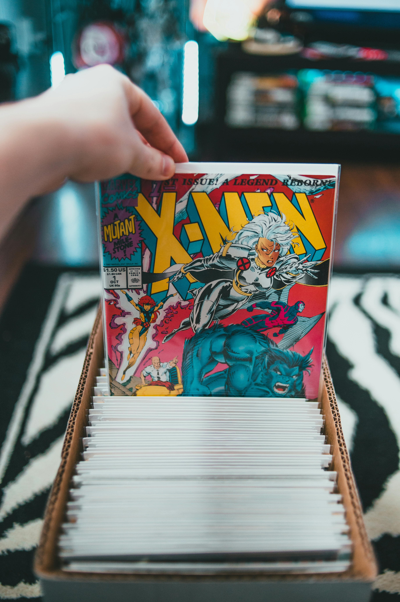
Sunshine's Impact and Protection
Spectral distribution: crucial for diverse applications.
Applications: solar energy, vitamin D synthesis, photochemical reactions.
Atmosphere filters harmful ultraviolet radiation.
Ozone layer protects from genetic damage.

Slide 5

Solar Measurement and Dangers
Solar irradiance: power per unit area (W/m²).
Key parameter for solar panel design and weather prediction.
Excessive exposure: sunburn, skin cancer, premature aging.
UV radiation damages skin cells and DNA.

Slide 6
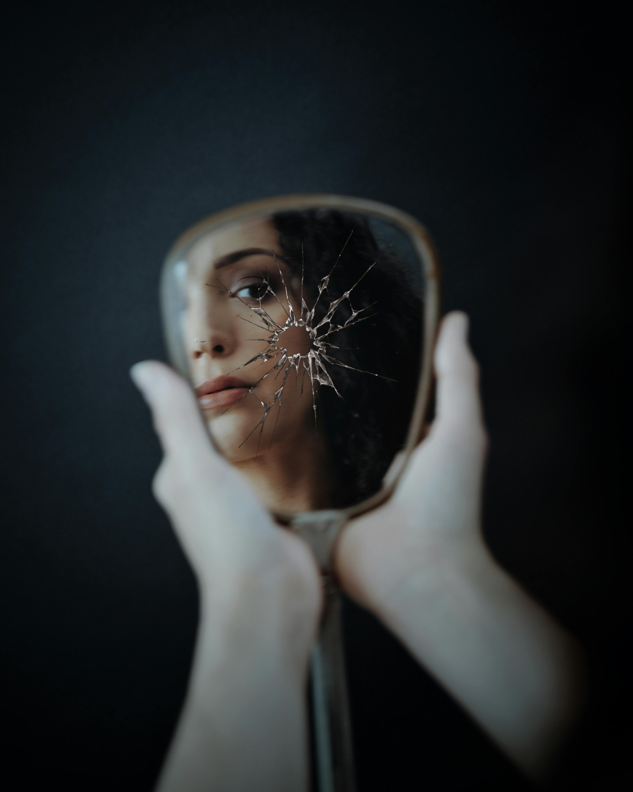
Sydney Sweeney: Early Career and Breakthrough
American actress: widespread recognition.
Roles in "Euphoria" and "The White Lotus."
Early roles in television shows.
Substantial parts in "Everything Sucks!" and "Sharp Objects."

Slide 7
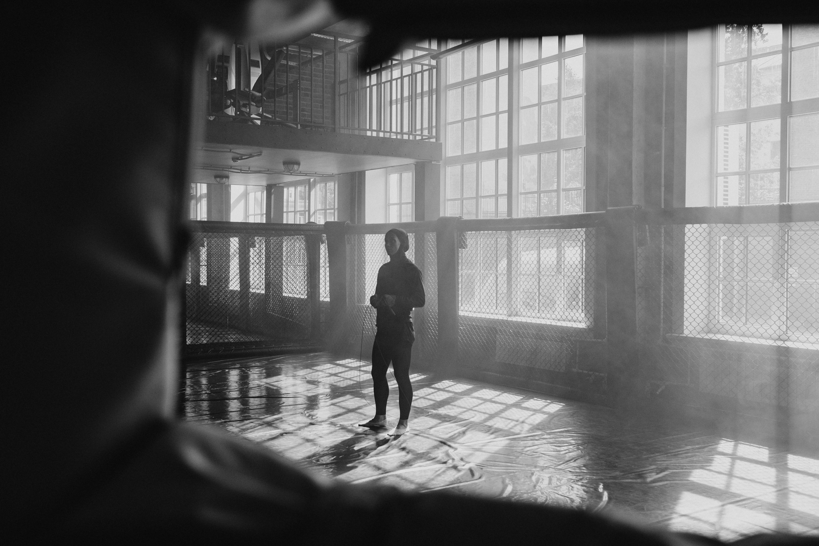
Sweeney's Acclaim and Business Acumen
Portrayal of Cassie Howard in "Euphoria": lauded.
Emotional depth and nuanced exploration of complex themes.
Strategic career: independent films and high-profile TV.
Producing demonstrates entrepreneurial spirit.

Slide 8

Sweeney's Disciplined Approach and Recognition
Background in mixed martial arts.
Informs physicality and disciplined approach.
Multiple Primetime Emmy Award nominations.
Solidifying her position as a rising star.

Slide 9
Sweeney's Influence and Sunshine Factors
Brand partnerships and endorsements: growing influence.
Aligning with fashion, beauty, and lifestyle companies.
Albedo effect: surfaces reflect solar radiation.
Angle of incidence affects energy absorbed.

